Slide 1
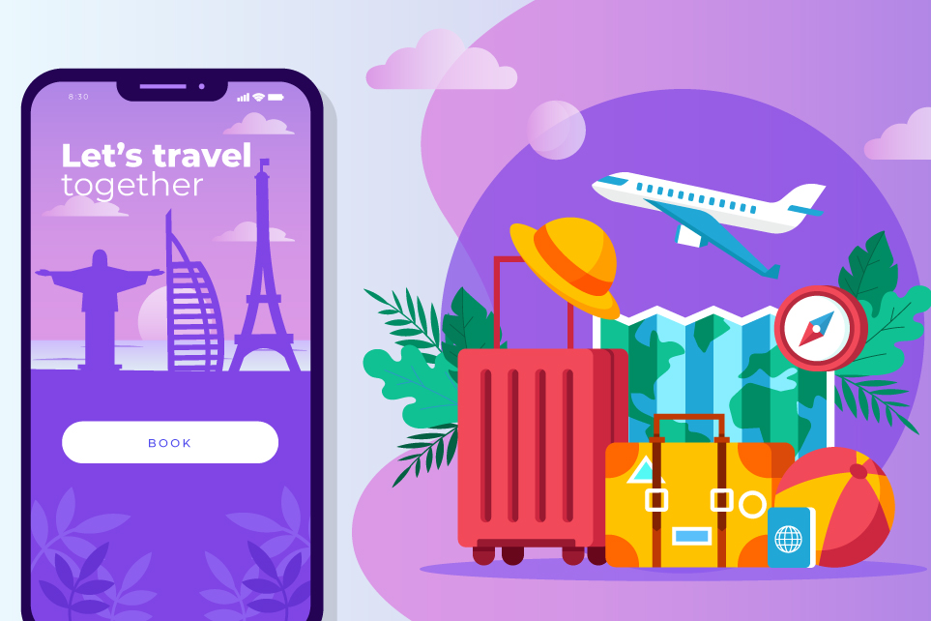
REAL LIFE LAB (RLL) PROJECT
PROJECT NAME : iMyTravel App
GROUP
10
Presented By :
1. Paturu Lavanya (2587071)
2. Pisini Pradeep (2587728)
3. Prajnaparimita (2587403)
4. Prasad Reddy (2586979)
5. Pushpa H R (2587833)
6. Ragul (2587029)
7. Ravuru Ashok (2587557)
8. Rishabh Saxena (2587626)

Slide 2
CONTENTS
Title
Contents
Modules
Objective
Introduction
Database schema
Admin and user components
Software requirements
Imytravel app
Testing reports
Conclusion
Thank you

Slide 3
MODULES
Name | Domain | Modules
1. Paturu Lavanya | FSD User | User Dashboard
2. Pisini Pradeep | FSD Admin/User | Welcome Page & Reset Password
3. Prajnaparimita | FSD User | Admin Dashboard
4. Prasad Reddy | FSD User | User Booking ,Comment
5. Pushpa H R | FSD User | Sign In
6. Ragul | FSD User | Sign Up
7. Ravuru Ashok | FSD User | Add Tour
8. Rishabh Saxena | FSD Admin/User | User Profile

Slide 4

OBJECTIVE
Comfortable for users
User-friendly
Flexible
Informative

Slide 5
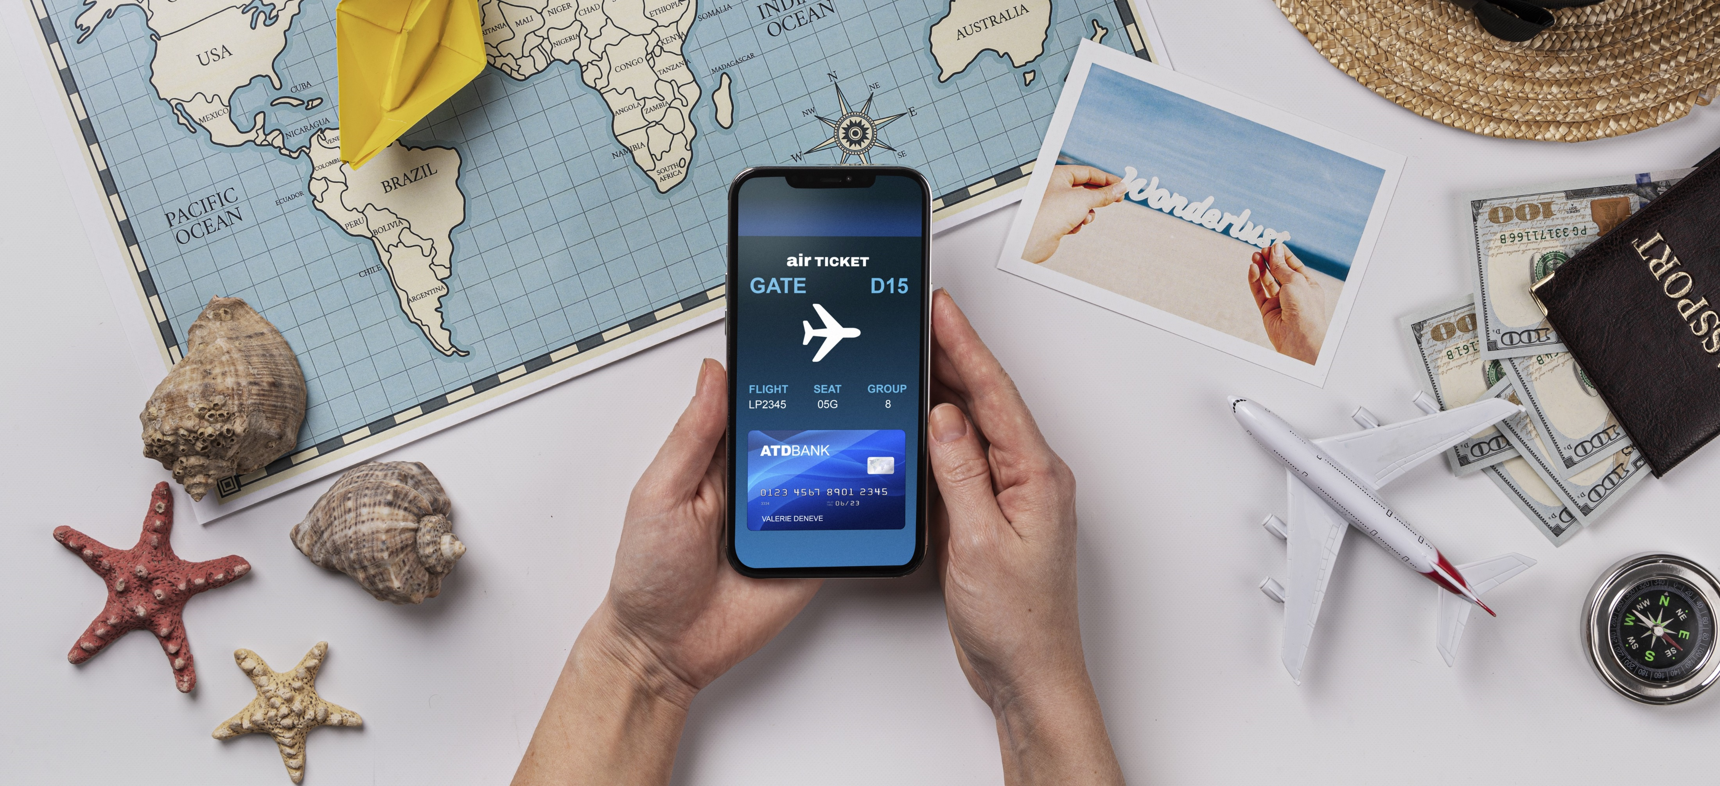
INTRODUCTION
iMyTravel App has two parts
i.Admin
ii.User
The Admin Section is like the control hub of our Application, giving users to explore the experiences of others.
Users can create personalized accounts, conveniently review, and explore the other users experiences with detailed descriptions, cost , climate and etc.

Slide 6

ADMIN AND USER COMPONENTS

Slide 7
ADMIN COMPONENTS
Welcome page
Admin dashboard
Admin Registration
Admin login
Reset Password
Edit user comments
Add comments

Slide 8
USER COMPONENTS
User dashboard
User register
User login
Reset Password
User profile
Place suggestions
Travel Experiences
Comments

Slide 9





Database: MySql Workbench Back-end: Spring Boot Suite Tool Front-End: Angular With VS-Code Testing: Postman Tool, Selenium Test Ng
SOFTWARE REQUIREMENTS

Slide 10
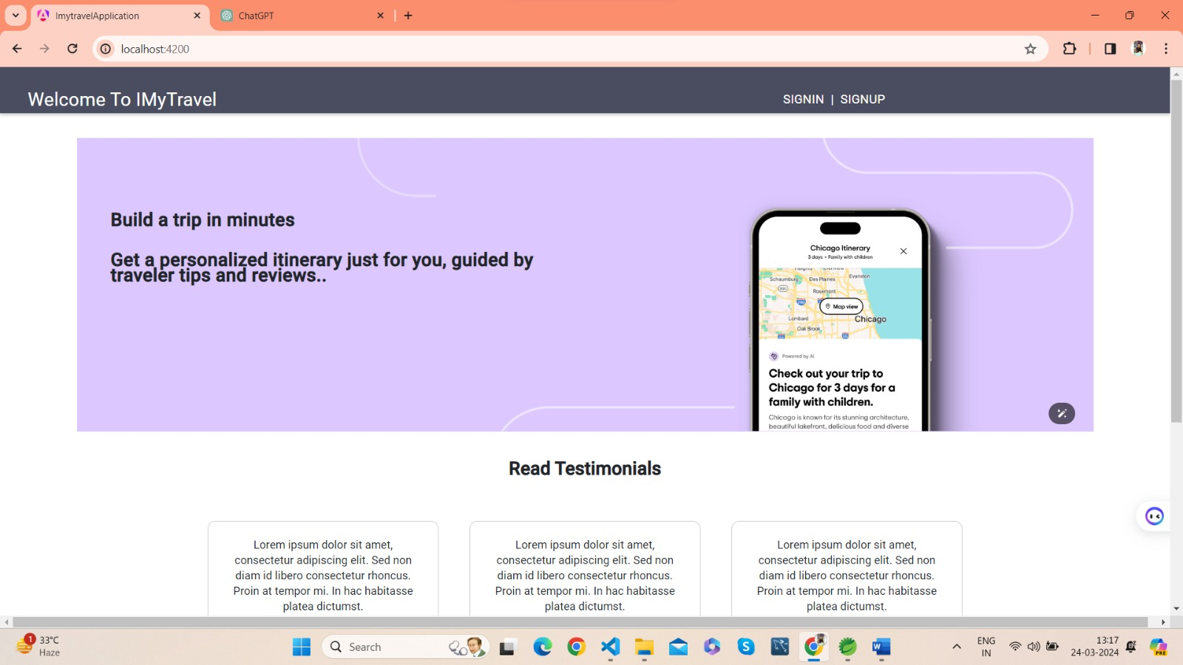
At welcome page we can access sign in and sign up Pages.
WELCOME PAGE

Slide 11
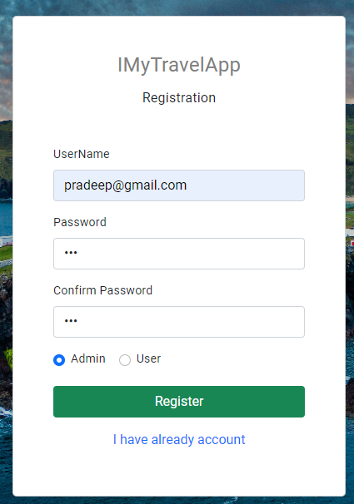
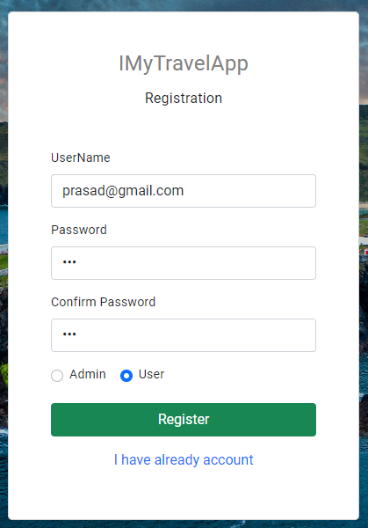
SIGN UP
In sign-up page the admin and users can able to register their profile by giving the user name and password.
If you want to enter into profile we need to create profile for admin/user.

Slide 12
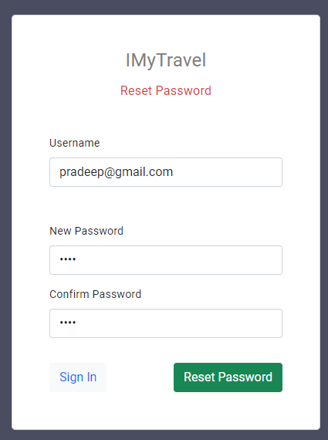
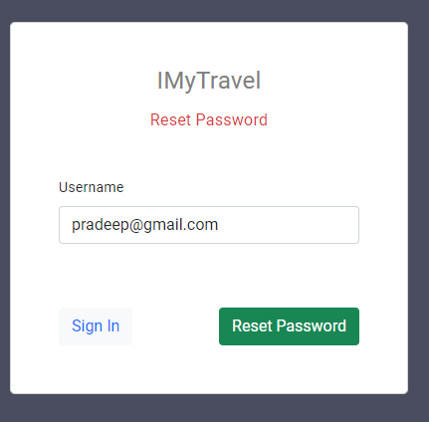
RESET PASSWORD
In reset password module the user and admin can reset the password by using their user name.
In Rest Page, the user & admin can give their email address for resetting password

Slide 13
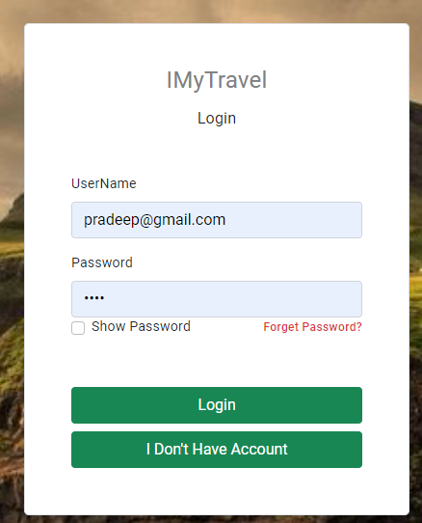
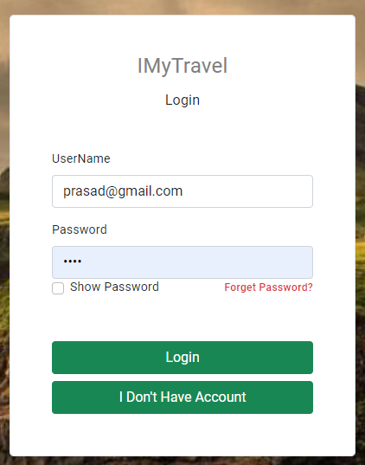
SIGN IN
In this page the admin and user can able to login to their profile using their credentials.
If the credentials doesn’t match then it shows an error.

Slide 14
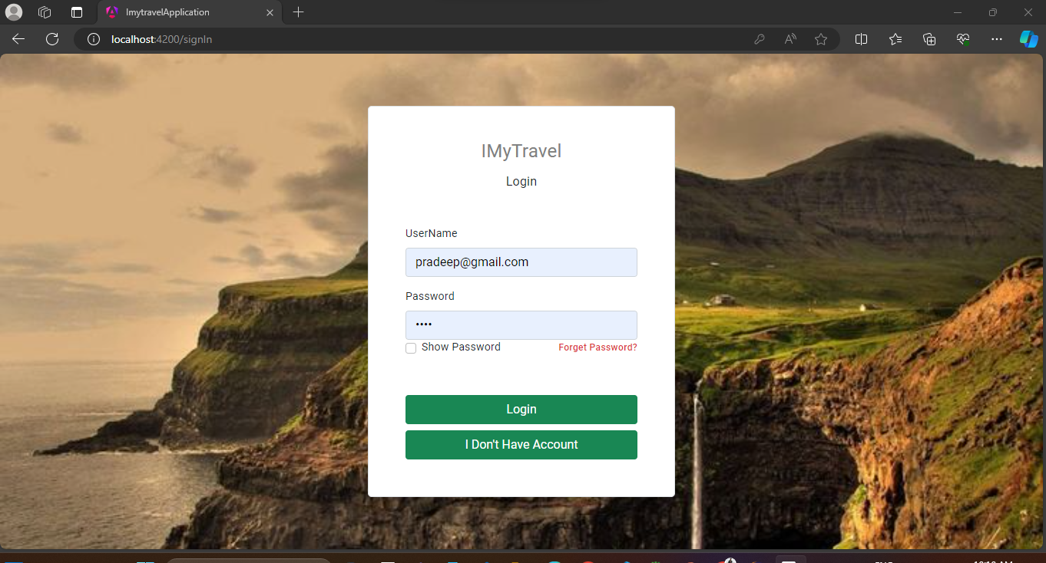
ADMIN LOGIN
Admin login is to validate admin credentials.
If credentials are matched, it will redirect to Admin dashboard
If we enter wrong credentials system will give message invalid credentials.

Slide 15
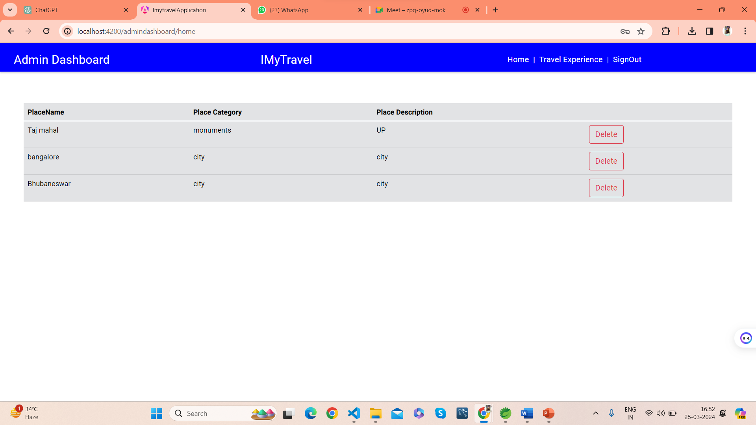
In this page admin can see all users added details like image, cost of travel ,Heritages ,Place to visit , Accessibility ,Transportation etc Also Admin can delete place detail also edit the comments
Admin Dashboard/ Home

Slide 16
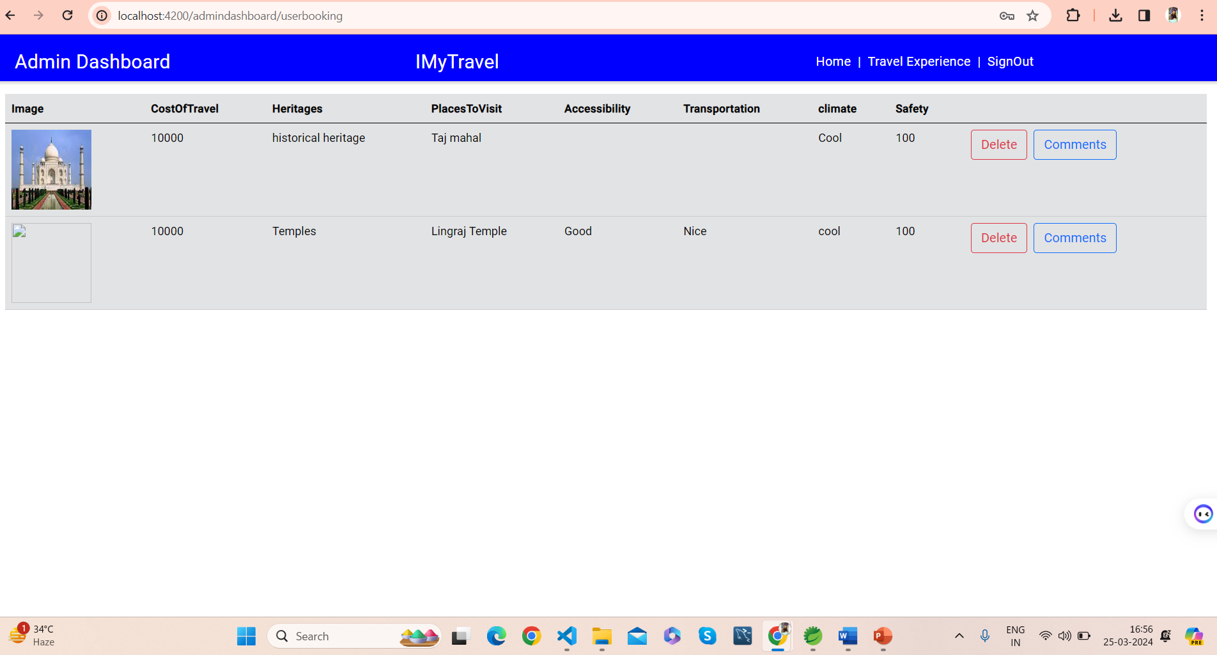
Travel Experience

Slide 17
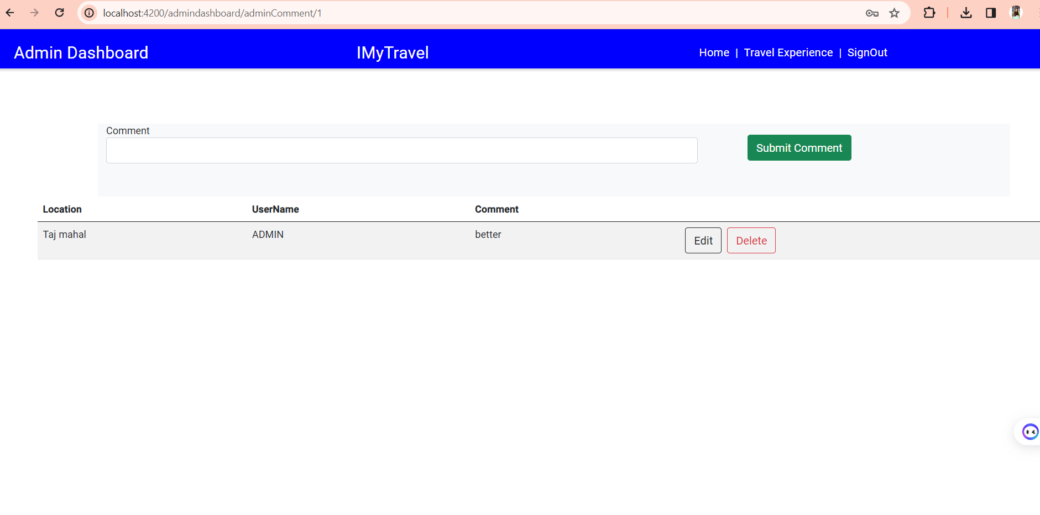
Admin Comment

Slide 18
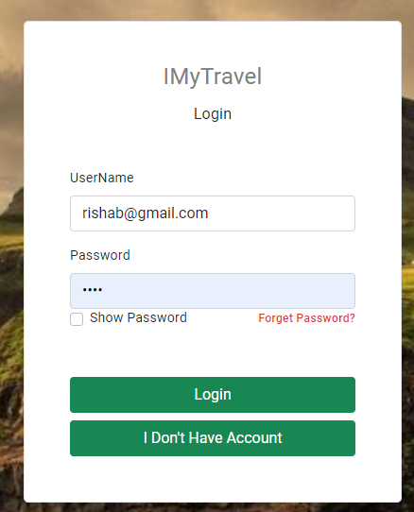
USER LOGIN
Here, The user first want’s to log-in and then go for the User Dashboard.

Slide 19
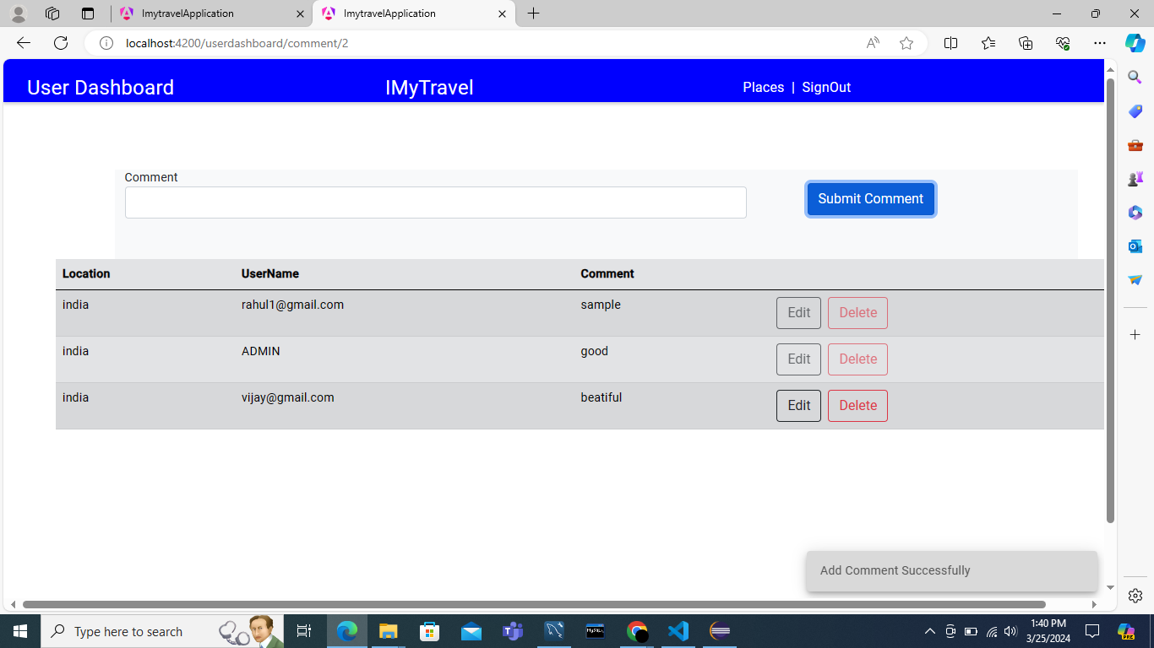
USER DASHBOARD/Home
On successful User login, redirected to User homepage/Dashboard.
In that page the user can able to add their travelled place and place category by clicking Places button. User also can able to sign out by clicking Sign out button

Slide 20
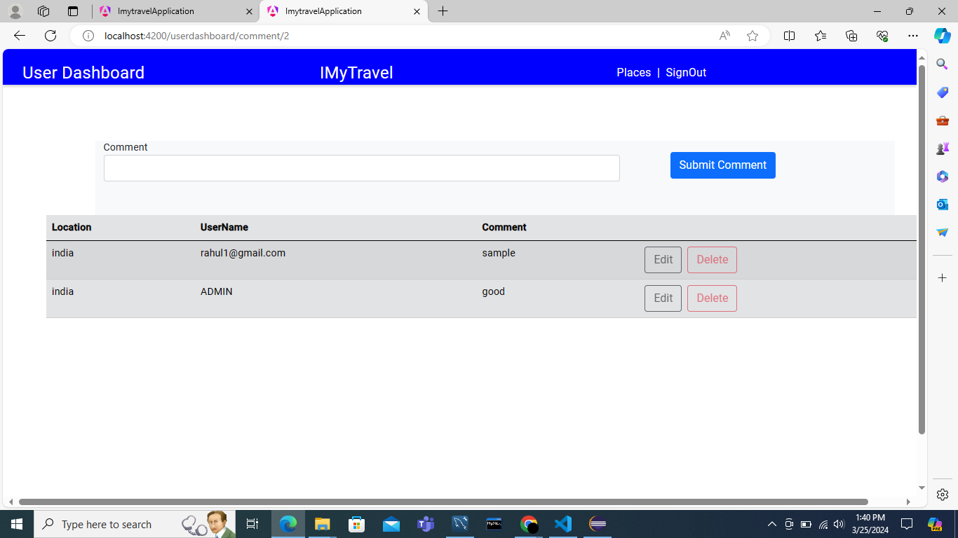
USER Comment
Input fields for place name, Place Category and description.
Options to Edit, Delete, or Add experience of each place.

Slide 21
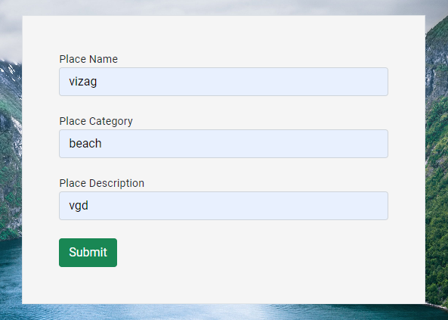
Add PLACE
If the user can travel the world anywhere and he can choose the place suggestion in this place suggestion.
By the user references the others can see the suggestion places to visit and then go to that places.

Slide 22
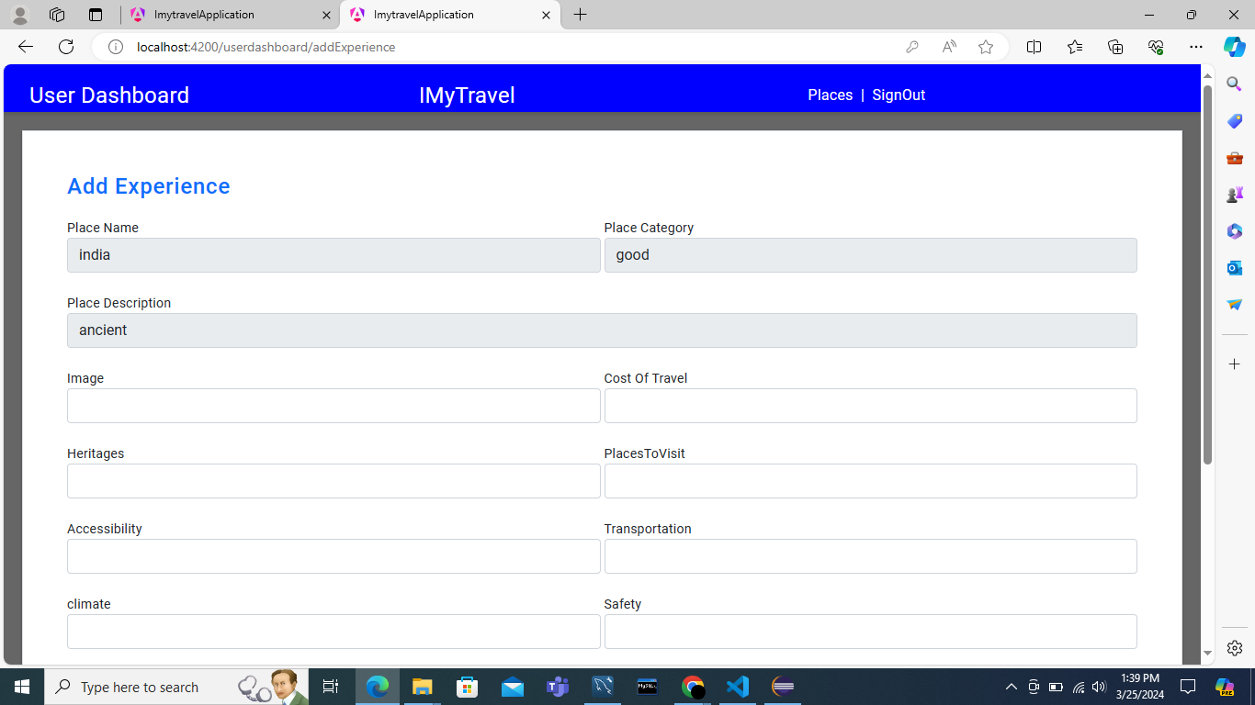
ADD EXPERIENCE
The User can explore their Travel Experience.
User Can Add the Cost Of travel And Add the travelling pictures and Some near places to visit.

Slide 23
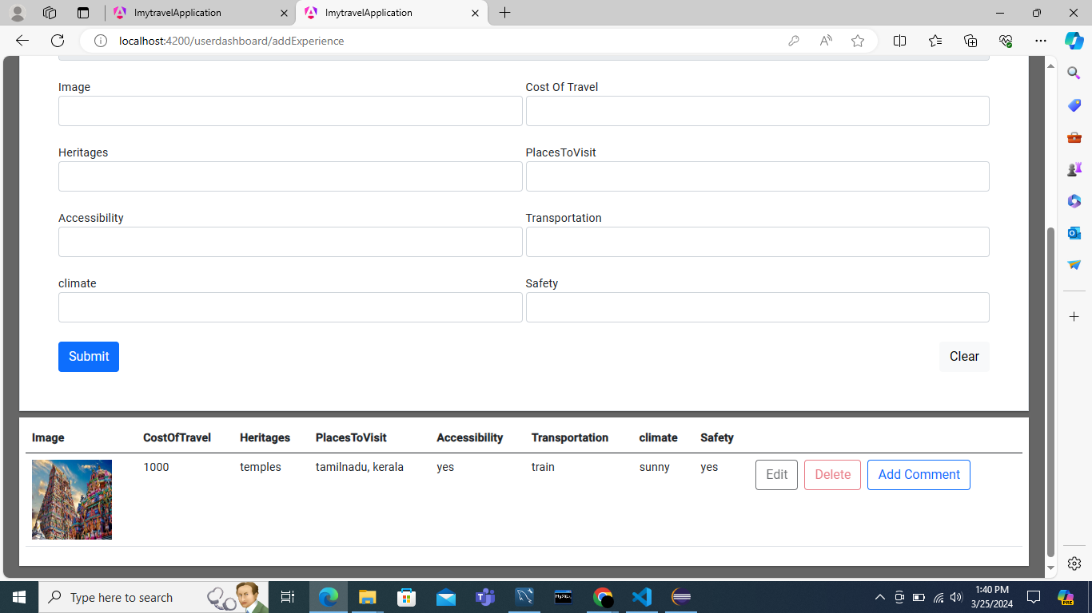
In this Comment module, the admin and user can able to add their own comments. In this Comment page user & admin can share their experiences in comments.
User comment

Slide 24
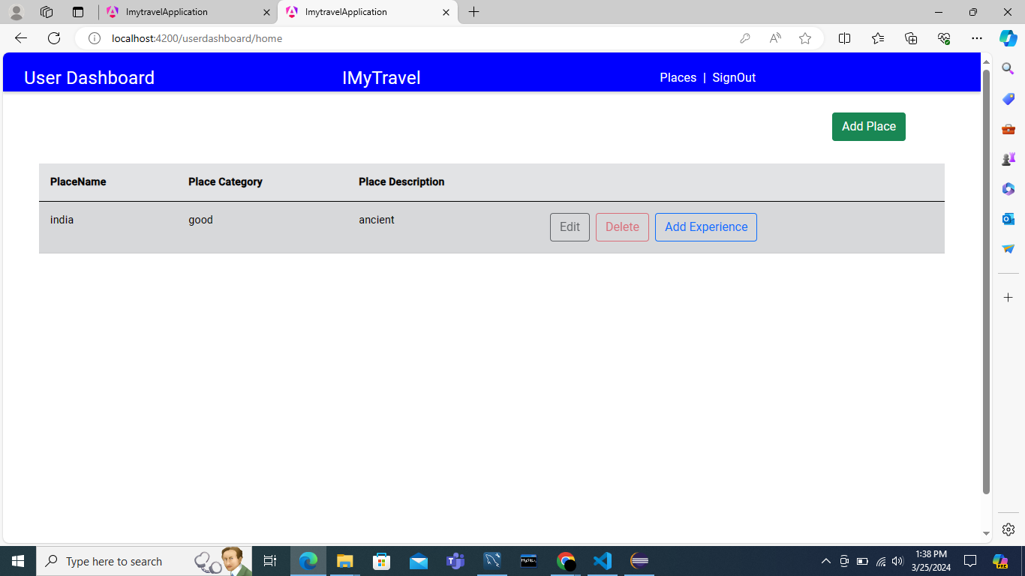
ADD COMMENT
In this add comment page the users should able to add their comments.
In that comment, they can add the places which they visited and they also add place suggestions to other users.

Slide 25
EDIT COMMENT
In this edit comment page the admin& user can edit and delete comment of the users.
If users commenting with mistakes the admin & user should able to edit it.
If users commenting something bad the admin have the right to delete the comment.

Slide 26

POSTMAN TESTING REPORTS

Slide 27
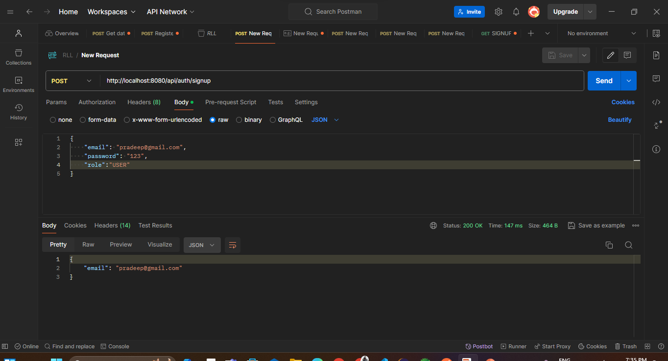
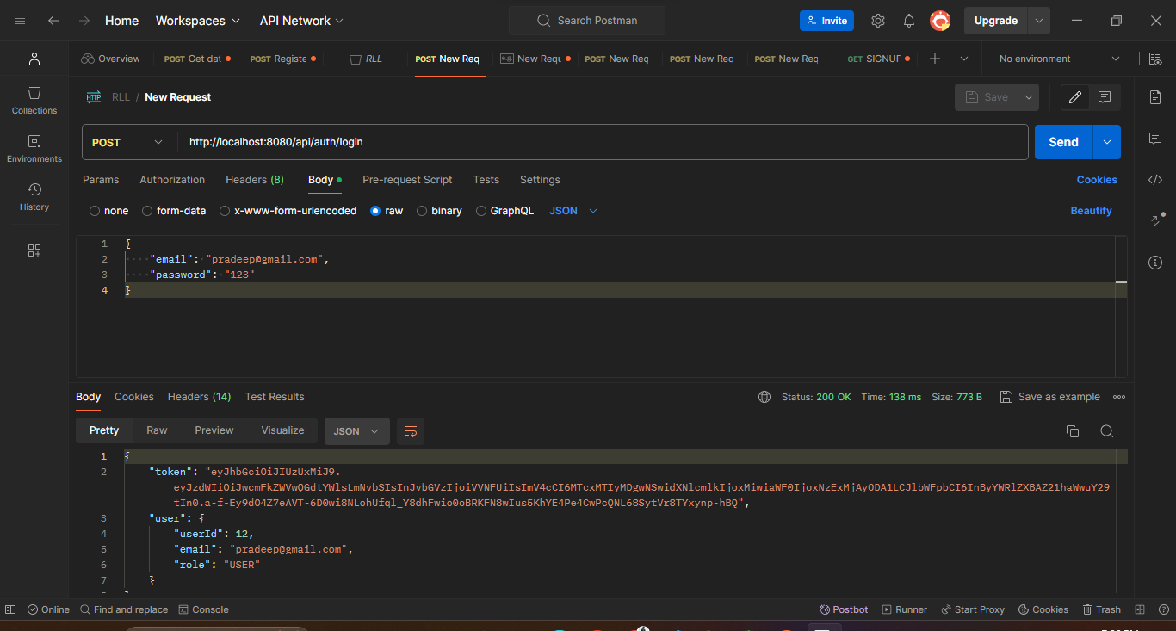
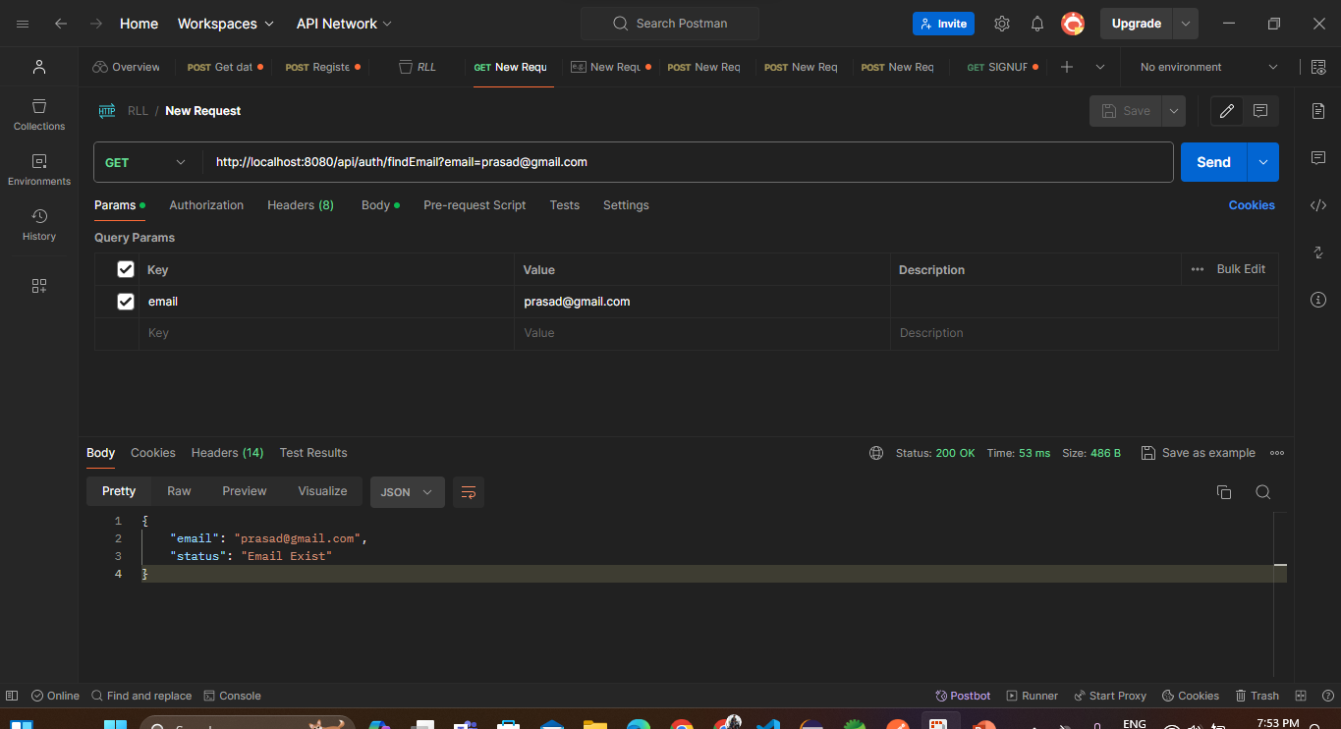
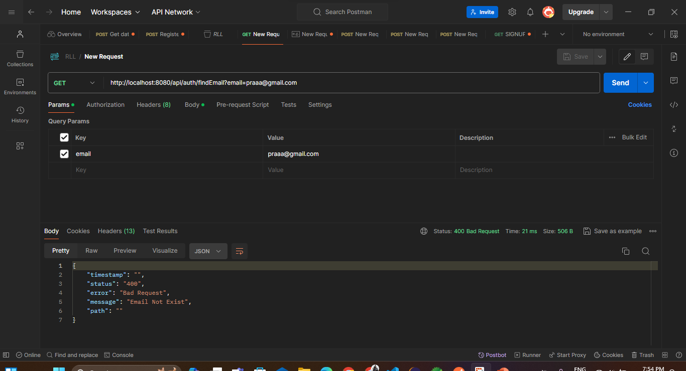
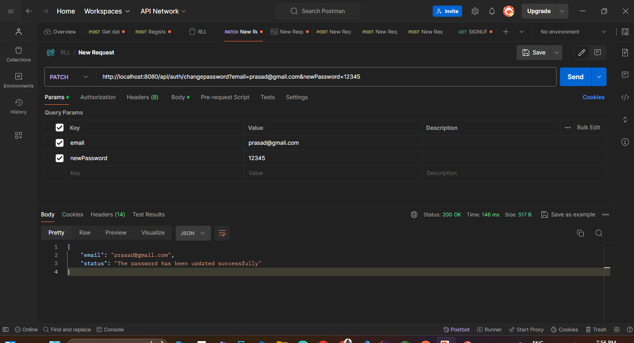
USER
Signup
login
FindEmail
Email NotFound
Change password

Slide 28
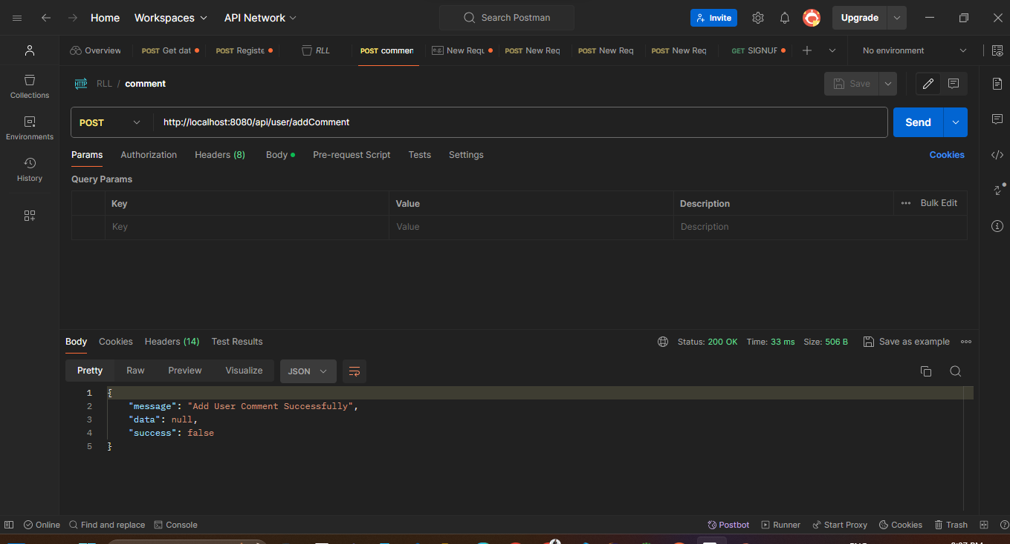
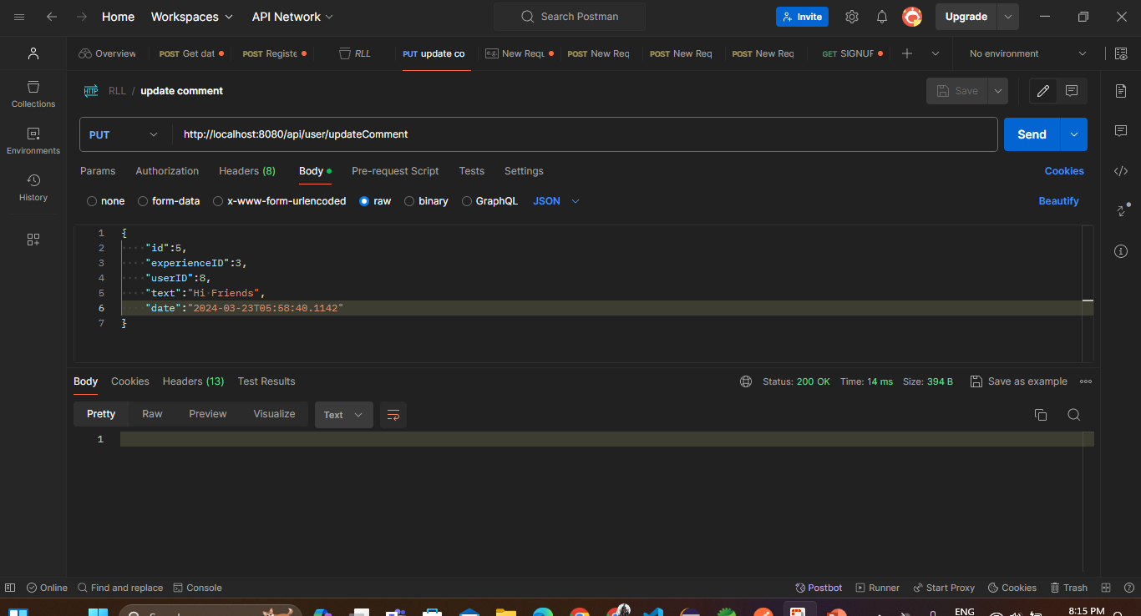
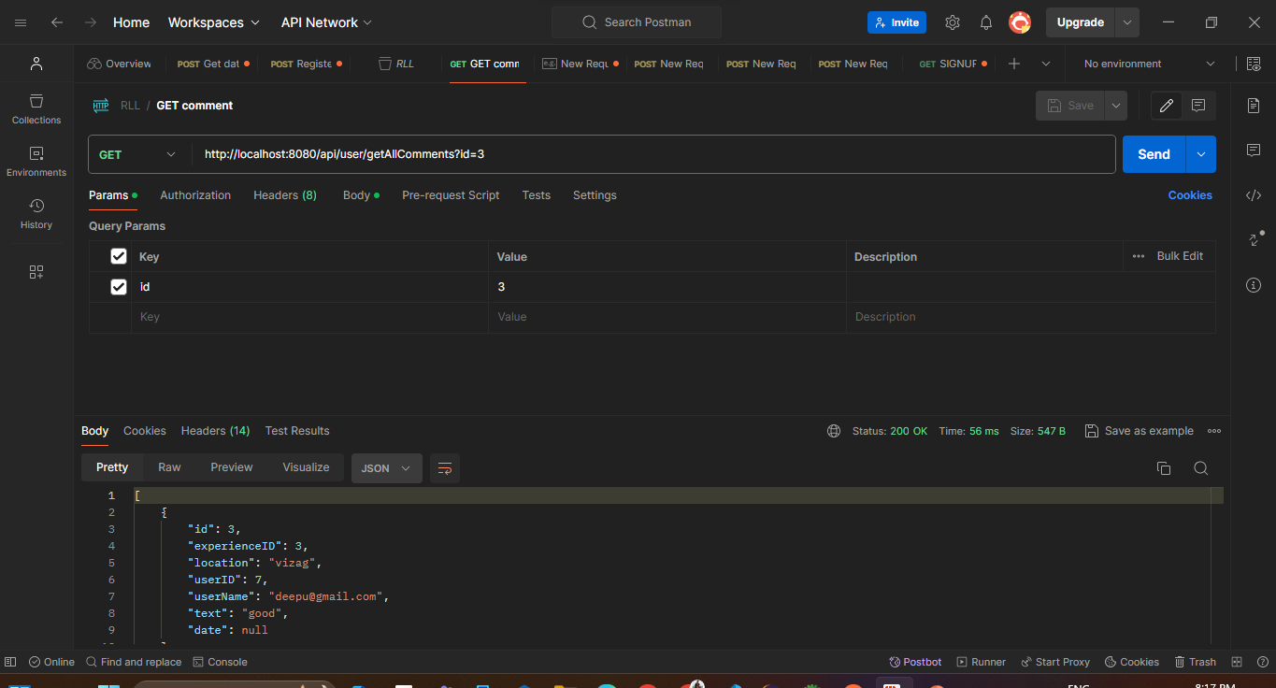
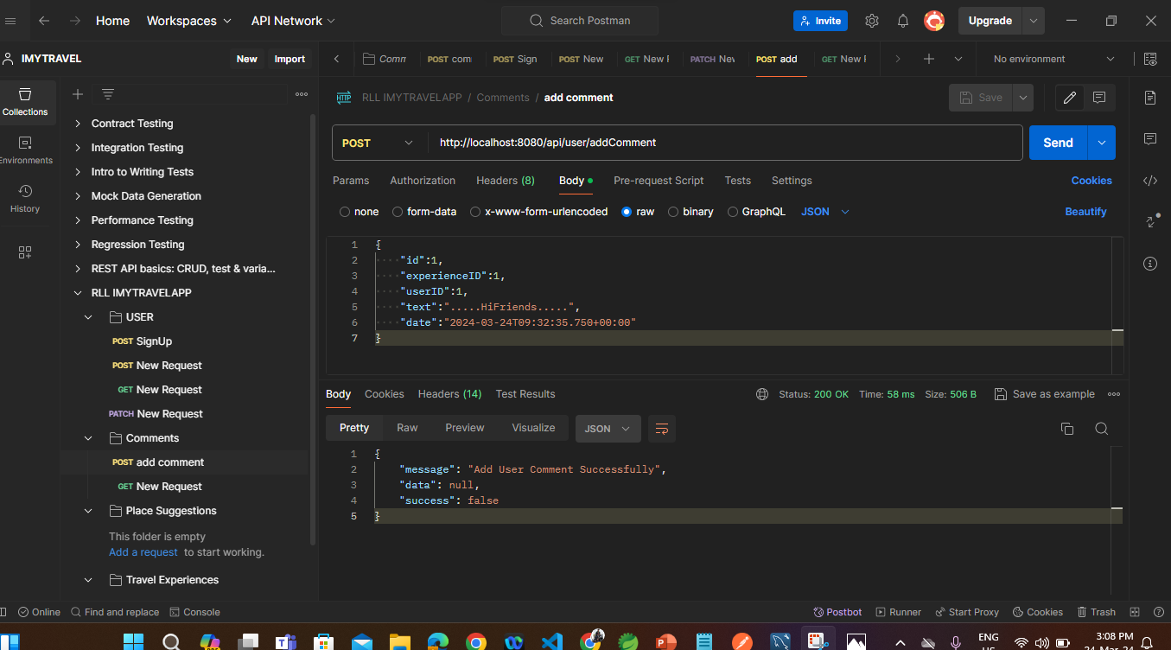
COMMENTS
Add comment
Update comment
Get comment
Delete comment

Slide 29
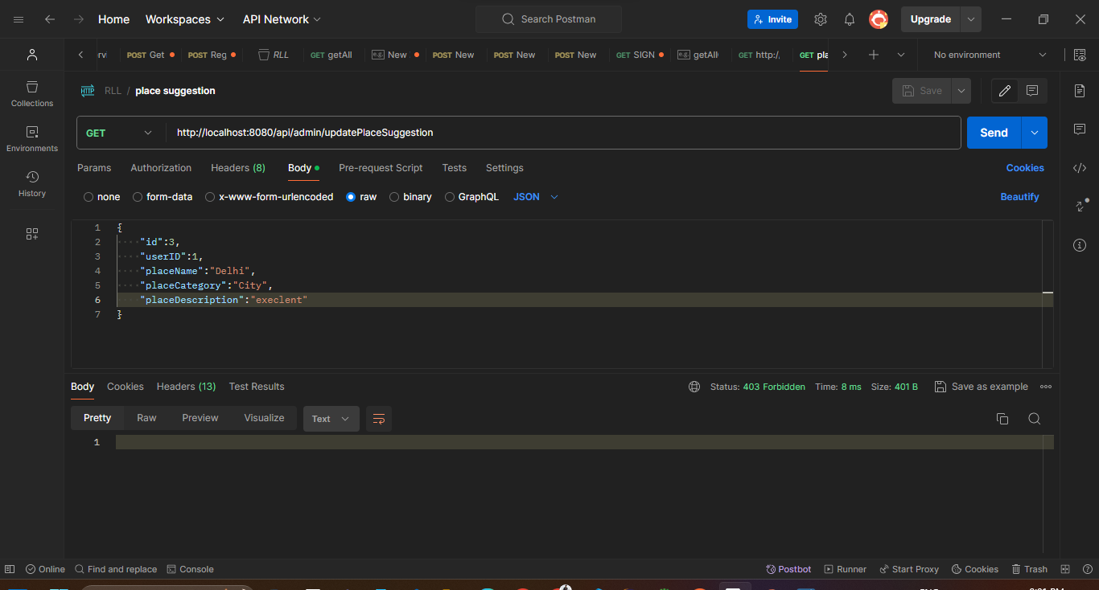
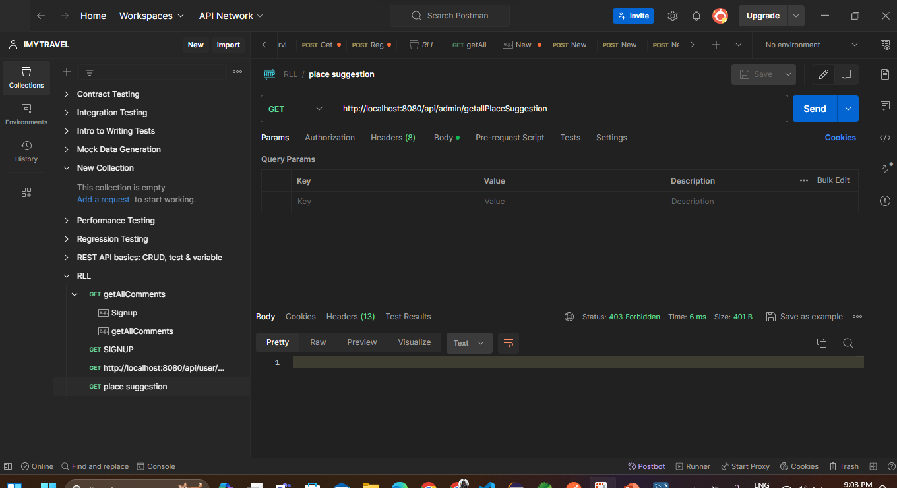
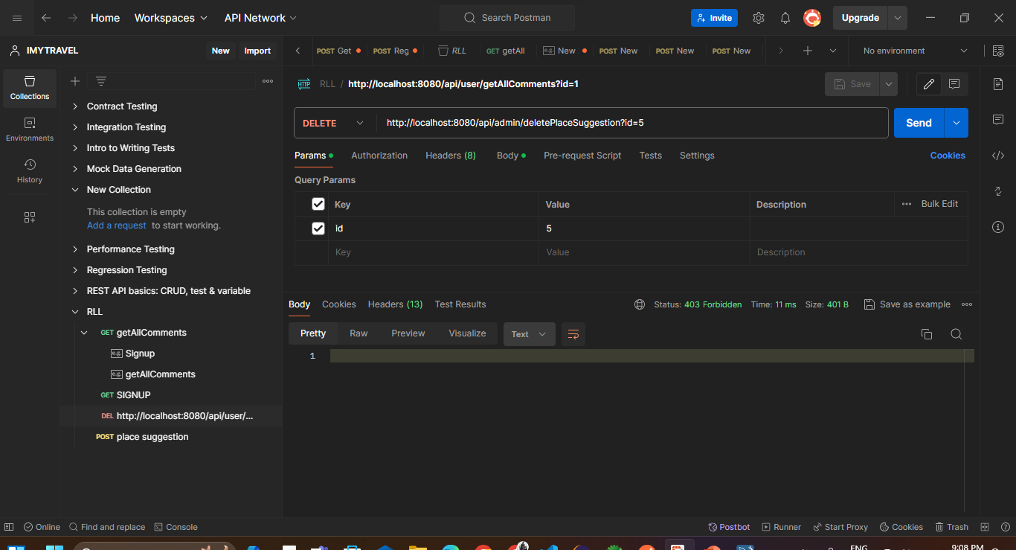
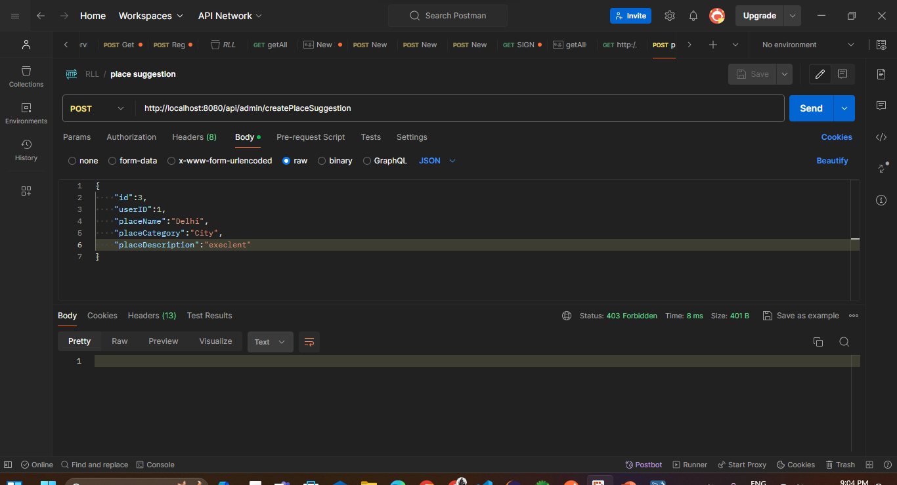
PLACE SUGGESTIONS
Update place
Get place
Delete place
Create place

Slide 30
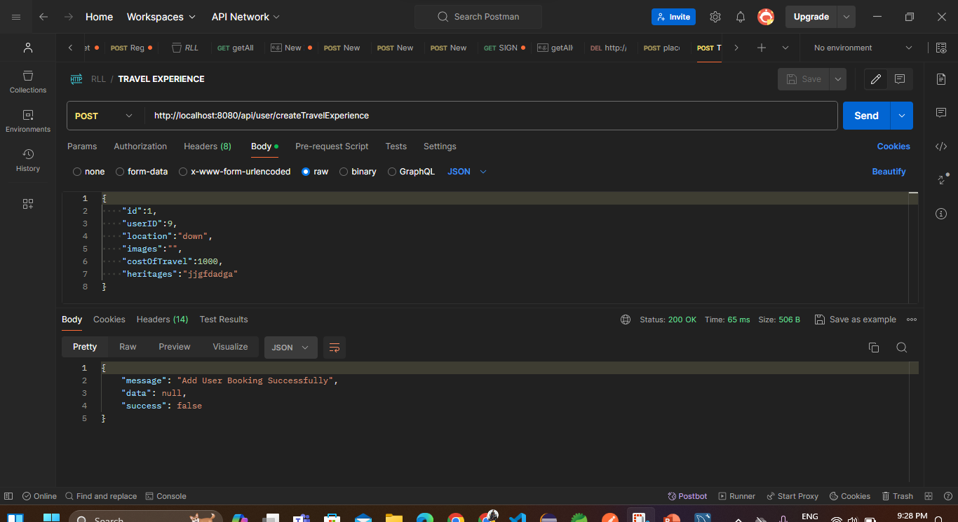
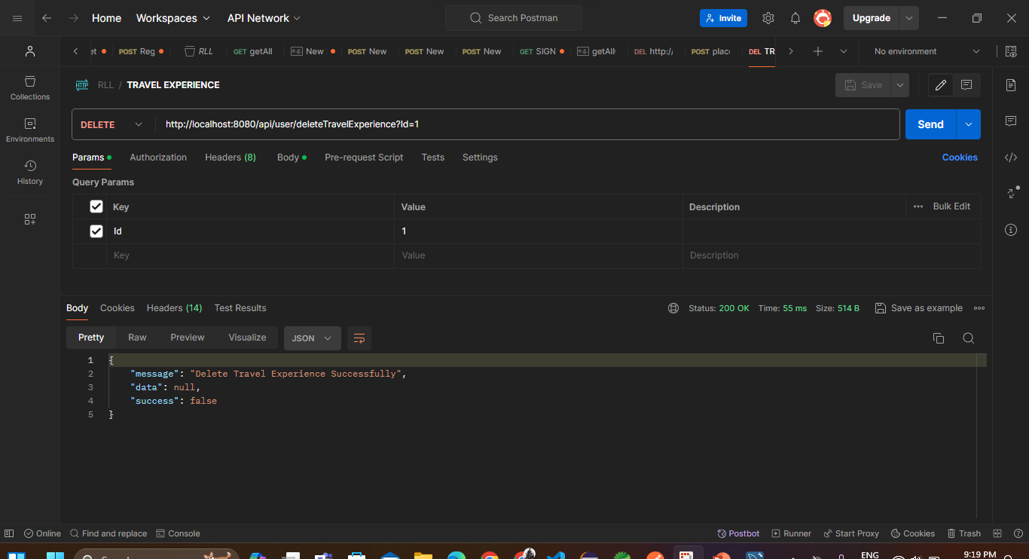
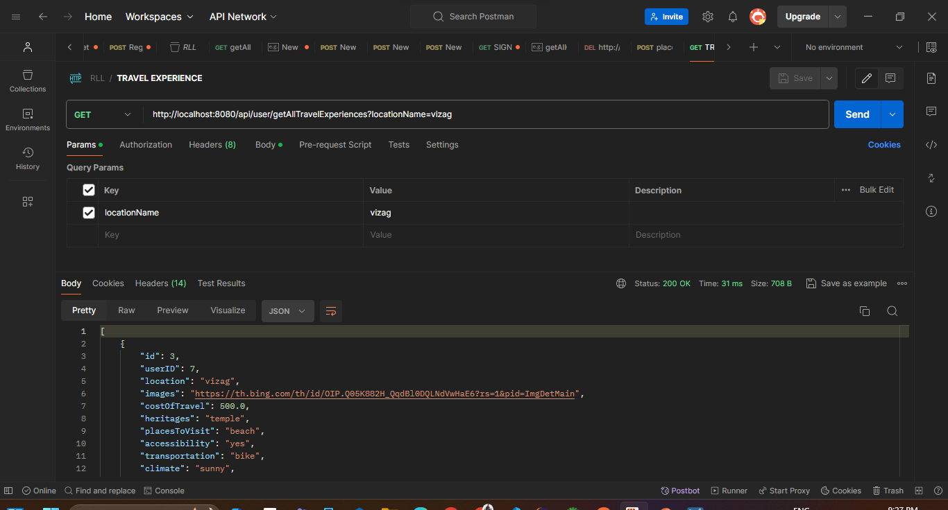
TRAVEL EXPERIENCES
Update Travel
Create Travel
Delete Travel
Get Travel

Slide 31

TESTING REPORTS

Slide 32
CONCLUSION
The iMyTravel Application, consisting of both the User and Admin sections.
Admin section provides a travel experiences , comments and place suggestions of the users and admin can add their own travel experiences.
The User section allows individuals to create personalized accounts, add their own travel experiences, comments of the places which they visited and explore other users experiences.

Slide 33

THANK YOU !

